Slide 1
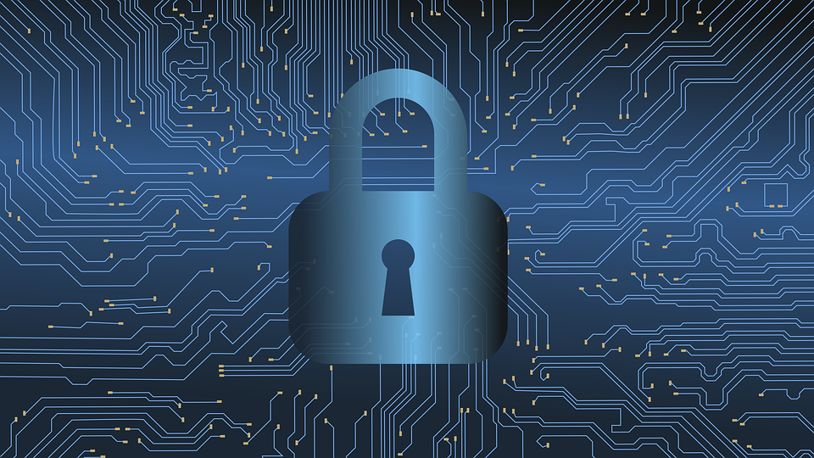
VPN Simulator
Hamid El Karim Marcus Waller and Ryan Ellis

Slide 2
What is a VPN?
A VPN(Virtual Private Network) is a framework that establishes a secure and private connection across a public network between your device and a server hosting the VPN.
VPNs encrypt traffic across the network making it inaccessible by third parties, Aswell as protect sensitive data(Personal Information, Passwords).
VPNs also mask your IP address with the VPN server’s IP address.

Slide 3
History of VPNs
The origins of VPNs come from Virtual Circuits, originally produced in the early 80’s
Virtual Circuits are easily implemented in highly connected networks while being very cost effective.
These Circuits create a logical path between two devices to ensure reliable data transfer, who path may contain hops between routers
As Virtual Circuit technology advanced, it brought the addition of encryption equipment that enciphered information between ports of the virtual circuit.

Slide 4
Why VPNs Matter
Cost Efficiency: VPNs are considerably cost effective for the consumer as apposed to the other alternative a high speed leased line. These lines are expensive and difficult to maintain and administrate.
Online Privacy: Masks IP Address, hiding your location and identity on the internet. Encrypts internet traffic prevent ISPs, hackers, or governments from tracking your activity. This also adds an extra layer of protection against cyber attacks DDoS attacks and phishing.
Bypassing Geo-Restriction: Allows users to access websites and content that is blocked in certain countries.

Slide 5
VPN Protocols
Open VPN: a highly secure, and versatile tunneling protocol that uses the Secure Socket Layer encryption protocol (SSL) in tandem with AES-256 encryption to ensure robust security. Has cross-platform compatibility and is Open-source but requires more computational power compared to newer protocols
IKEv2/IPsec: Internet Key Exchange v.2 is a tunneling protocol based on IPsec that establishes VPN connection and defines negotiations and authentication processes for IPsec security associations. Know for its stability and high speed making it ideal for mobile users.
PPTP: Point-to-Point Tunneling Protocol is one of the earliest VPN protocols, used for simple application. Very easy to set up and fast but is quite outdated and vulnerable to security exploits.

Slide 6
AES-256
AES stands for Advanced Encryption Standard and the 256 refers to the length of the encryption key which is 256 bits
AES-256 is one of the most highly secure encryption protocols used in many modern VPN protocols.
Its considered a military-grade encryption due to its resistance to brute-force attacks.

Slide 7
AES-256 Cont.
AES-256’s robust security comes from large key size. While crackable theoretically it would take an enormous amount of computing power and time to break.
AES-256 takes a file or data that you would like to encrypt, and transforms said data using a 256-bit key.
The encryption process involves a series of steps called rounds where a series of transformations occur and are repeated between rounds, using a new 128-bit key derived from the 256-bit master key being the difference.

Slide 8
How VPNs Work
Overview of how your VPN simulator functions

Slide 9
Demo / Screenshots
Code outputs

Slide 10
Pros and Cons

Slide 11
Real World VPN Services
NordVPN and those type of things

Slide 12
Threat Models
Who VPNs protect users from

Slide 13
Interactive Question (optional)
Ask classmates a simple VPN-related question

Slide 14
Conclusion
Summarize the project and lessons learned

